Slide 1


INTRODUCING JBOSS AMQ 7
Flexible messaging for the enterprise, cloud, & IoT
Confidential - Do not duplicate or distribute without written permission from Red Hat

Slide 2
Red Hat JBoss AMQ 7
Standard protocols
Flexible, standards-based messaging for the enterprise, cloud and Internet of Things
Broker
New broker core with modern async architecture
Improved performance and scalability
Interconnect
Message router
High-performance direct messaging
Distributed messaging backbone
Clients
New set of AMQP 1.0 clients
Support for AMQ 6.x and HornetQ clients for backward compatibility
Common tooling
Confidential - Do not duplicate or distribute without written permission from Red Hat

Slide 3
Standard Protocols
Confidential - Do not duplicate or distribute without written permission from Red Hat

Slide 4



Advanced Message Queuing Protocol AMQP v1.0
Open, standard messaging protocol
General-purpose message transfer protocol that enables cross-platform apps to be built using brokers, libraries and frameworks from different vendors
International Standard ISO/IEC 19464
Features
Efficient – binary, connection-oriented protocol
Reliable – range of guarantees, fire-&-forget to reliable, exactly-once delivery
Portable data representation – cross-platform, full-fidelity message exchange
Sophisticated flow control – credit-based flow control & channel multiplexing
Flexible – client-client, client-broker & broker-broker topologies
Broker-model independent – no requirements on broker internals
ISO/IEC 19464:2014
http://www.amqp.org
Confidential - Do not duplicate or distribute without written permission from Red Hat
Notes:
Highlight differences between 1.0 and 0.x
Supported by Red Hat, Microsoft, IBM, SwiftMQ, RabbitMQ (experimental)

Slide 5
AMQP Concepts
Container A
Container B
Connection
Session
Node A1
Link 1
Node B1
Node A2
Link 2
Node B2
Containers (clients, brokers, …) connect to other containers
Connections manage transfer capacity (frame size, channel count, …)
Bidirectional Sessions created over Connection. Byte-based flow control.
Links are created over Sessions for unidirectional message transfer. Credit-based flow control.
Confidential - Do not duplicate or distribute without written permission from Red Hat

Slide 6

Message Queuing Telemetry Transport MQTT v3.1.1
Open, standard messaging protocol
Lightweight publish/subscribe messaging transport for the Internet of Things
International Standard ISO/IEC 20922
Features
Efficient – binary, connection-oriented protocol
Reliable – range of guarantees, fire-&-forget to reliable, exactly-once delivery
Lightweight – minimal overhead of business payload
Simple message format – messages are simple arrays of bytes
Pub/sub model – defines hierarchical pub/sub broker model
ISO/IEC 20922:2016
http://www.mqtt.org
Confidential - Do not duplicate or distribute without written permission from Red Hat

Slide 7
AMQ 7 Broker
Confidential - Do not duplicate or distribute without written permission from Red Hat

Slide 8

Broker consolidation
A-MQ 6
Apache ActiveMQ Community
AMQ 7
ActiveMQ 5
ActiveMQ Artemis
ActiveMQ 5
ActiveMQ Artemis
EAP 6
HornetQ
EAP 7
HornetQ
ActiveMQ Artemis
Confidential - Do not duplicate or distribute without written permission from Red Hat

Slide 9
Protocols and clients
AMQP Clients
Community MQTT Clients
Community STOMP Clients
A-MQ 6.x Clients
HornetQ / Artemis JMS Client
JMS, C++, Python, JavaScript/Node.js,
.NET, …
JMS, C++ (CMS),
.NET (NMS)
AMQP
MQTT
STOMP
OpenWire
Artemis “Core”
AMQ 7 Broker
Confidential - Do not duplicate or distribute without written permission from Red Hat

Slide 10
AMQ 7 Broker vs. EAP 7 Broker
Feature | AMQ 7 | EAP 7
High performance broker based on ActiveMQ Artemis | ✓ | ✓
JMS 2.0 client library using “Core” protocol | ✓ | ✓
AMQP 1.0 protocol support | ✓ | ✗
MQTT protocol support | ✓ | ✗
OpenWire protocol support | ✓ | ✗
Confidential - Do not duplicate or distribute without written permission from Red Hat

Slide 11
AMQ 7 Broker: headline features
Pure Java, high-performance message broker
Multi-protocol: AMQP 1.0, MQTT, STOMP, OpenWire, HornetQ Core
Polyglot: Java JMS 2.0, C++, .NET, Python, JavaScript (inc. Node.js)
Flexible persistence: high performance journal or JDBC
Support for large messages
Flexible clustering
High availability: shared SAN or shared nothing
Confidential - Do not duplicate or distribute without written permission from Red Hat

Slide 12
AMQ 7 Broker: internal architecture
Fully asynchronous (non-blocking) internal architecture
Developed using reactive patterns
Netty IO
Thread pooling
Predictable thread usage (not 1 thread per client/queue/*)
Configurable thread pools
High performance journal
Custom implementation using Linux asynchronous I/O (JNI to libaio)
Automatically switches to Java NIO implementation when not on Linux
Compaction
Confidential - Do not duplicate or distribute without written permission from Red Hat

Slide 13
AMQ 7 Broker: clustering
Balance message processing across several broker nodes
Brokers can be grouped into clusters
Explicit configuration, discovery using UDP multicast, JGroups, …
Messages arriving on cluster are balanced to different nodes to spread the load – default balancing is round robin
Balancing takes into account selectors and consumers on each node
Confidential - Do not duplicate or distribute without written permission from Red Hat

Slide 14
AMQ 7 Broker: high availability
Node A
Node B
Live 1
Live 2
Backup 3
Backup 1
Live 3
Backup 2
Node C
Backup 3
Boom!
Live 3
Backup 2
Live 3
Confidential - Do not duplicate or distribute without written permission from Red Hat

Slide 15
AMQ 7 Interconnect
Confidential - Do not duplicate or distribute without written permission from Red Hat

Slide 16
AMQ 7 Interconnect
AMQP-native message router based on Apache Qpid Dispatch Router
Influenced by Red Hat MRG Messaging use cases
Supports high performance direct messaging
Best effort or end-to-end guaranteed delivery
1-to-1 or 1-to-many
Can be used a single instance or connected as a network
Network offers shortest-path routing with redundancy
Can be used standalone or in conjunction with broker
Confidential - Do not duplicate or distribute without written permission from Red Hat

Slide 17
AMQ 7 Interconnect
Router Config
A: anycast
Router
Router
A
A
Client A
Client B
Client C
Client D
Client E
Confidential - Do not duplicate or distribute without written permission from Red Hat

Slide 18
AMQ 7 Interconnect
Router Config
B: multicast
Router
Router
B
B
Client A
Client B
Client C
Client D
Client E
Confidential - Do not duplicate or distribute without written permission from Red Hat

Slide 19
AMQ 7 Interconnect + Broker
Broker
queue.A
Router Config
address:
prefix: queue, waypoint = true
connector:
host: bhost, port: amqp, name: broker1
autoLink
addr: queue.A, connector: broker1, dir: in
autoLink
addr: queue.A, connector: broker1, dir:out
Router
queue.A
Client A
Client B
Confidential - Do not duplicate or distribute without written permission from Red Hat

Slide 20





INTERCONNECT USE-CASE
Hybrid cloud
Traffic shaping
Cloud-bursting
Fault tolerance
Confidential - Do not duplicate or distribute without written permission from Red Hat

Slide 21
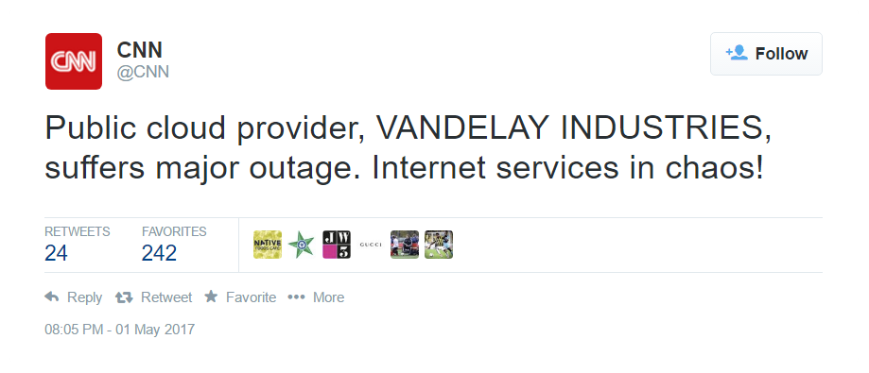
INTERCONNECT USE-CASE
Hybrid cloud
Traffic shaping
Cloud-bursting
Fault tolerance
Confidential - Do not duplicate or distribute without written permission from Red Hat

Slide 22
INTERCONNECT USE-CASE
Hybrid cloud
Traffic shaping
Cloud-bursting
Fault tolerance
Confidential - Do not duplicate or distribute without written permission from Red Hat

Slide 23
Comparing broker vs. router
 | AMQ 7 Broker | AMQ 7 Interconnect Router
Role | Intermediary between clients | Intermediary between clients
Protocol | Supports AMQP (and others) | Supports AMQP
Patterns | 1:1 (queue) & 1:many (topic) | 1:1 (anycast) & 1:many (multicast)
Delivery guarantees | Best-effort or guaranteed delivery | Best-effort or guaranteed delivery
Ownership | Takes ownership of messages | Does not take ownership of messages
Contracts | 2: sender-broker & broker-receiver | 1: sender-receiver
High availability | Provided by broker clustering | Provided by redundant topology
Confidential - Do not duplicate or distribute without written permission from Red Hat

Slide 24
AMQ 7 Clients
Confidential - Do not duplicate or distribute without written permission from Red Hat

Slide 25

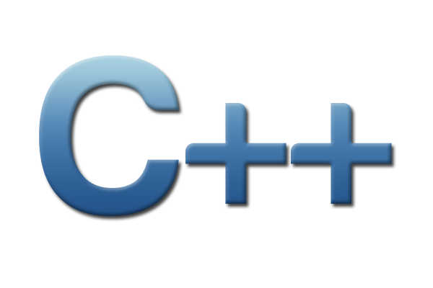




AMQP 1.0 client libraries for AMQ 7 Broker and Interconnect
Java JMS 2.0 client (Apache Qpid JMS based on Qpid Proton)
Reactive C++ client (Apache Qpid Proton)
Reactive Python client (Apache Qpid Proton)
Reactive pure JavaScript client w support for Node.js (GitHub Rhea)
Fully-featured .NET library (GitHub AMQP .NET Lite)
Confidential - Do not duplicate or distribute without written permission from Red Hat

Slide 26
Backward compatibility client libraries for AMQ 7 Broker
A-MQ 6.x (OpenWire)
Java JMS 1.1 client
C++ CMS client (ActiveMQ-CPP)
.NET NMS client (ActiveMQ-NMS)
HornetQ (Artemis ‘Core’ protocol)
Java JMS 2.0 client
Confidential - Do not duplicate or distribute without written permission from Red Hat

Slide 27
Common Tooling
Confidential - Do not duplicate or distribute without written permission from Red Hat

Slide 28
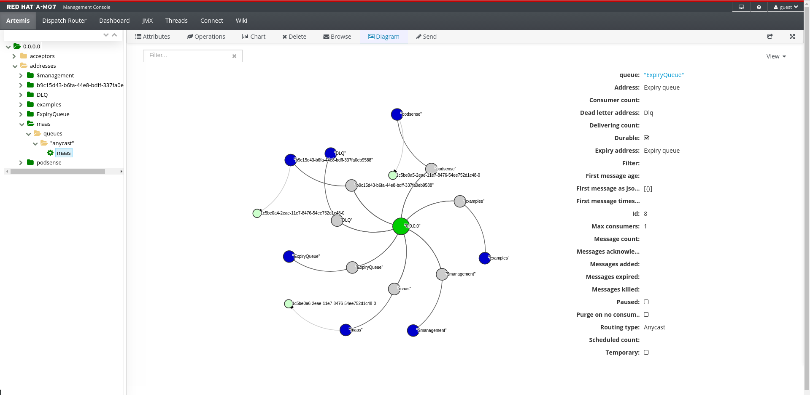
Amq 7 TOOLING Broker
Confidential - Do not duplicate or distribute without written permission from Red Hat

Slide 29
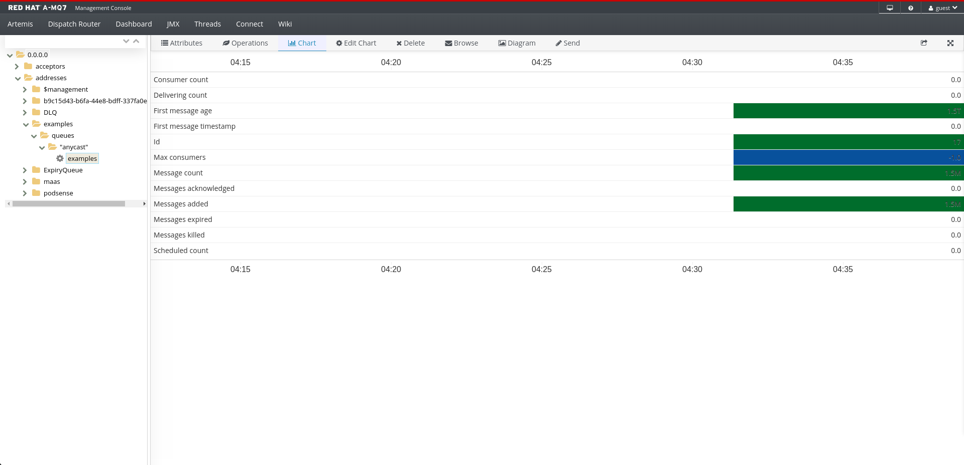
Amq 7 TOOLING broker
Confidential - Do not duplicate or distribute without written permission from Red Hat

Slide 30
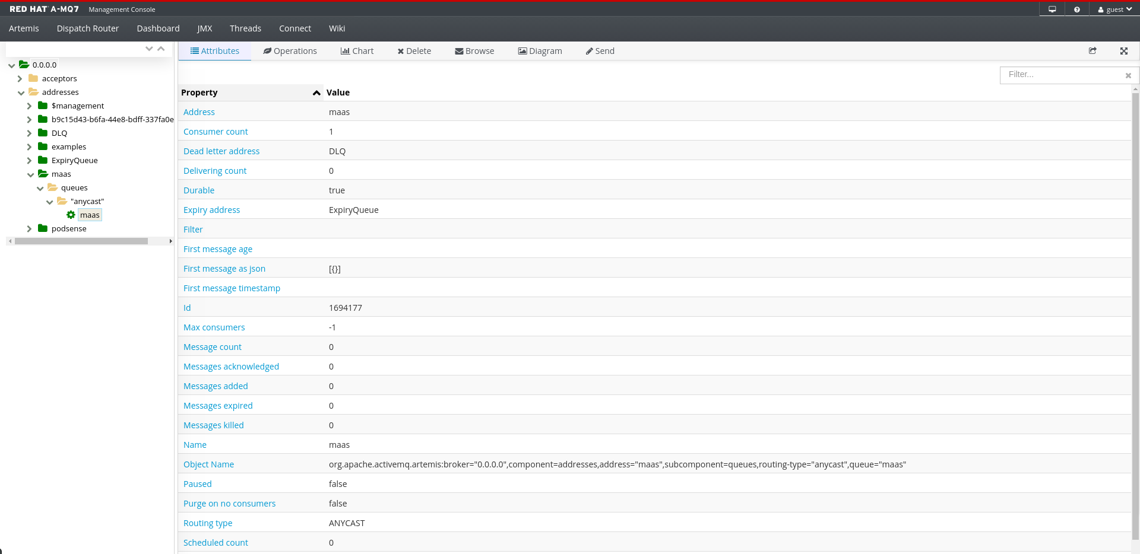
Amq 7 TOOLING broker
Confidential - Do not duplicate or distribute without written permission from Red Hat

Slide 31
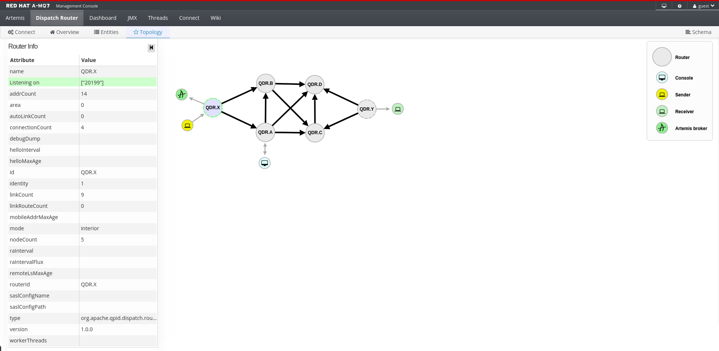
Amq 7 TOOLING interconnect
Confidential - Do not duplicate or distribute without written permission from Red Hat

Slide 32
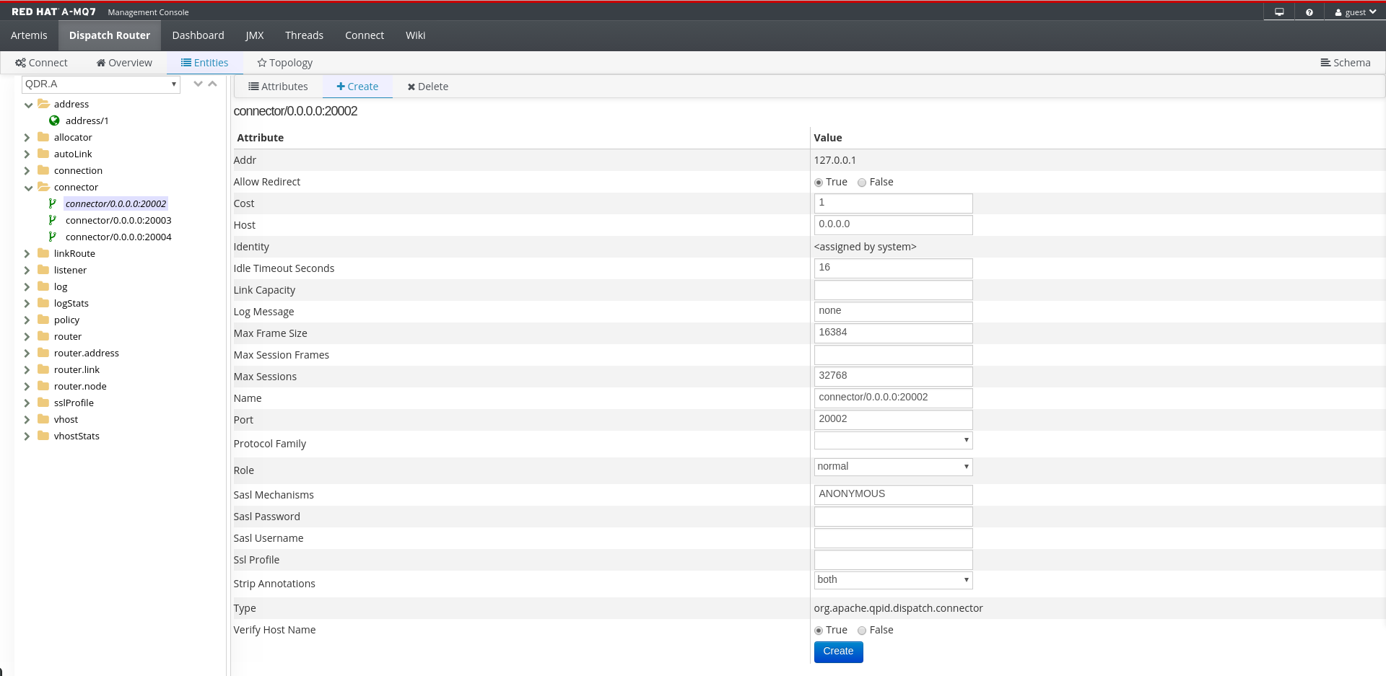
Amq 7 TOOLING interconnect
Confidential - Do not duplicate or distribute without written permission from Red Hat

Slide 33
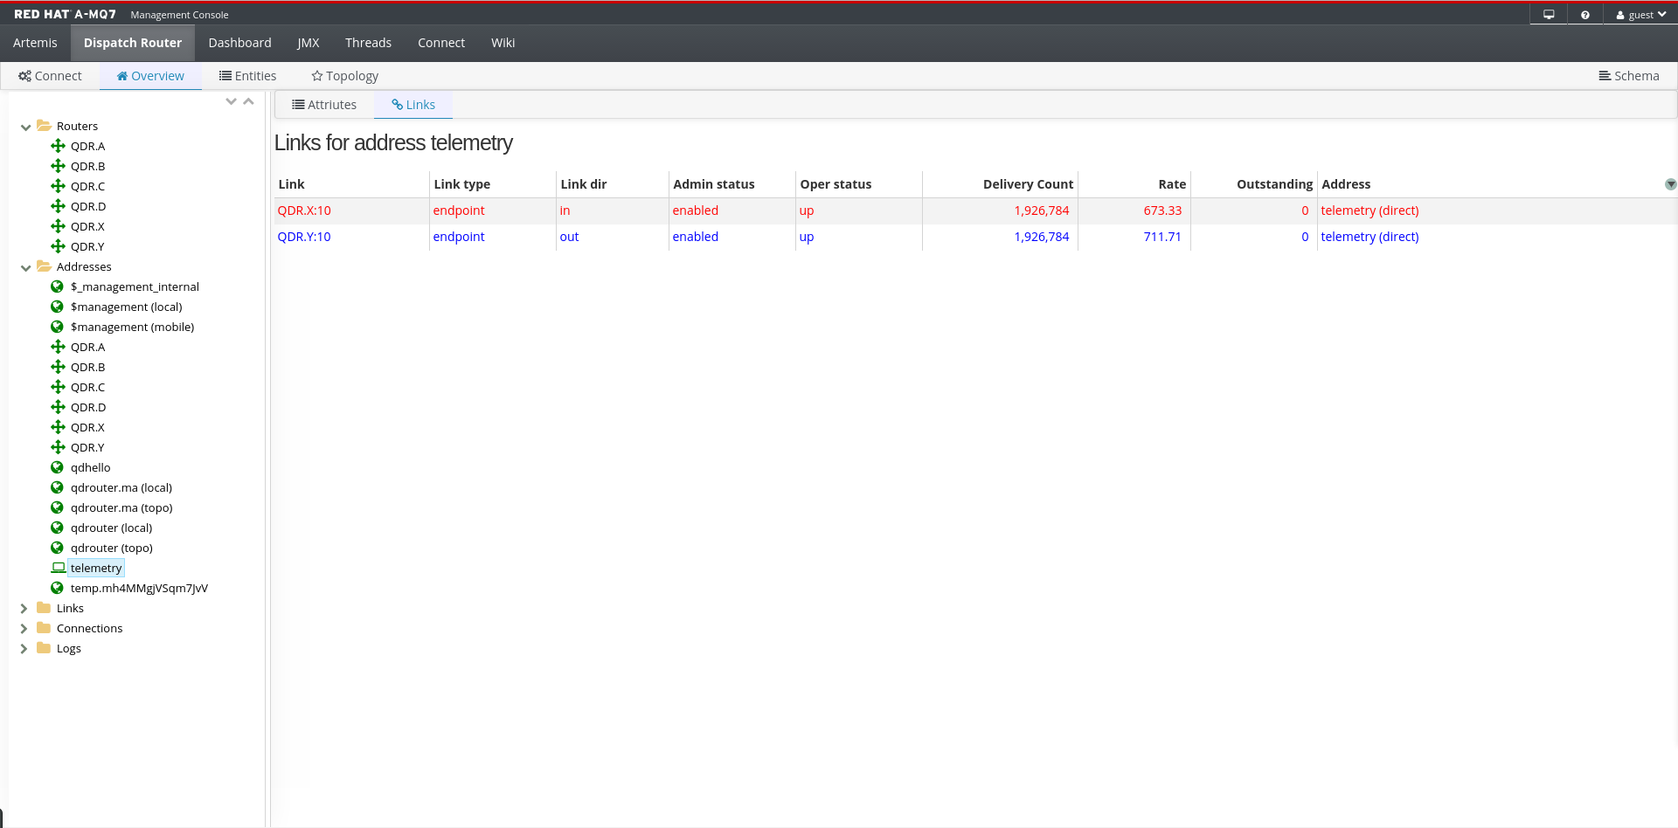
Amq 7 TOOLING interconnect
Confidential - Do not duplicate or distribute without written permission from Red Hat

Slide 34
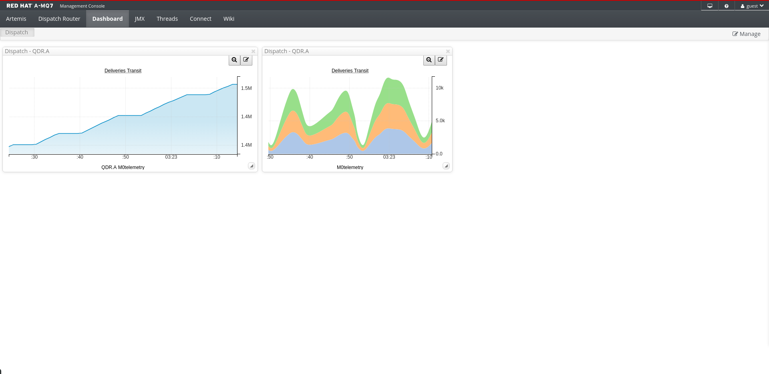
Amq 7 TOOLING interconnect
Confidential - Do not duplicate or distribute without written permission from Red Hat

Slide 35
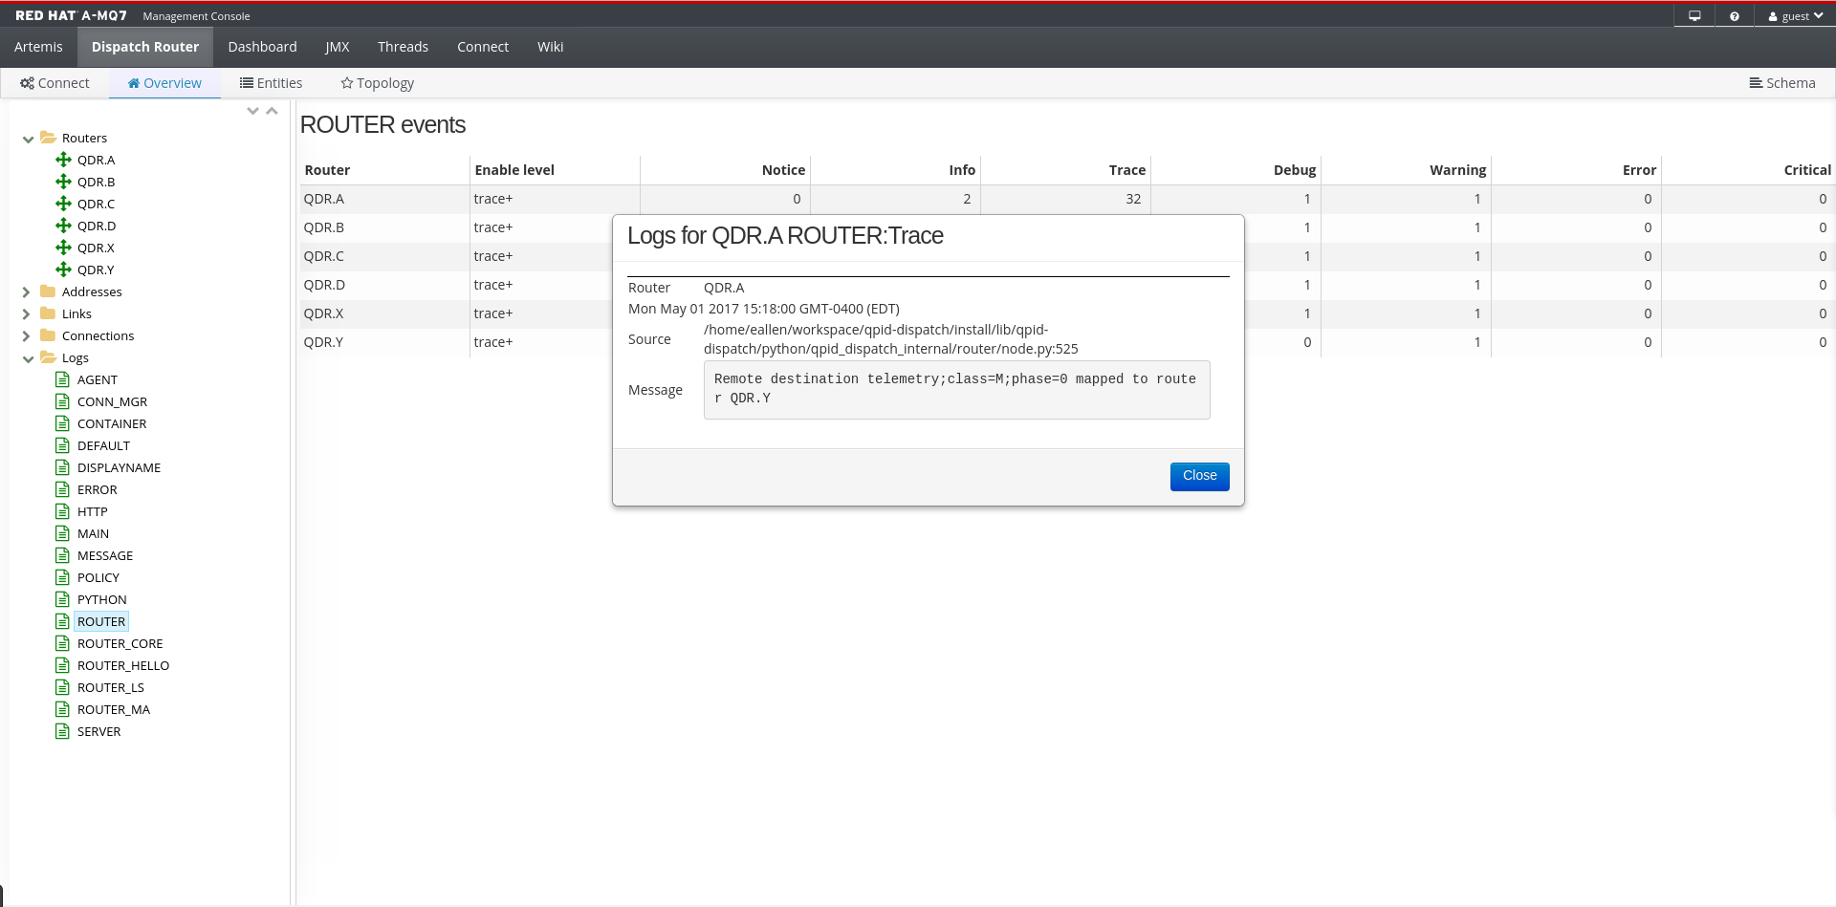
Amq 7 TOOLING interconnect
Confidential - Do not duplicate or distribute without written permission from Red Hat

Slide 36
Messaging-as-a-Service
Note: MaaS is still under active development. Preview releases planned during 2017.
Confidential - Do not duplicate or distribute without written permission from Red Hat

Slide 37

Messaging-as-a-Service (MaaS)
Elastic-scale messaging utility built using AMQ 7 components on OpenShift
AMQ Interconnect (Qpid Dispatch Router)
AMQ Broker (ActiveMQ Artemis)
Protocol gateways based on Eclipse Vert.x
MaaS specific services
Under active development at https://enmasseproject.github.io/
Confidential - Do not duplicate or distribute without written permission from Red Hat

Slide 38
Messaging-as-a-Service (MaaS)
Separation of concerns
Application provisioning and monitoring vs. infrastructure administration
Multi-tenancy
Different namespaces
Permissions, quotas and limits
Support a variety of communication patterns
Queues and pub/sub topics (store & forward)
Direct 1-way point-to-point and pub-sub/events
Request-response (point-to-point & service pool)
Support a variety of different protocols
AMQP, MQTT initially; HTTP(1.1& 2), CoAP, STOMP, … to follow
Confidential - Do not duplicate or distribute without written permission from Red Hat

Slide 39
Messaging-as-a-Service (MaaS)
Handle scale in various dimensions
Number of communicating endpoints (i.e. connections)
Aggregate message volume
Number of distinct addresses (or paths)
Number of producers and consumers on given address
Examples:
Inflow of large volume of sensor events for processing
Making requests on a large number of connected devices
Broadcasting events to a large number of subscribers
Elasticity
Add and remove capacity without disrupting communication
Confidential - Do not duplicate or distribute without written permission from Red Hat

Slide 40
MaaS declarative address definition
...
{
"apiVersion": "v3",
"kind": "AddressList",
"items": [
{
"metadata": {
"name": “A"
},
"spec": {
"store_and_forward": false,
"multicast": false
}
},
{
"metadata": {
"name": “B"
},
"spec": {
"store_and_forward": false,
"multicast": true
}
},
{
"metadata": {
"name": "myqueue"
},
"spec": {
"store_and_forward": true,
"multicast": false,
"flavor": "vanilla-queue"
}
},
{
"metadata": {
"name": "mytopic"
},
"spec": {
"store_and_forward": true,
"multicast": true,
"flavor": "vanilla-topic"
}
}
]
}
...
Confidential - Do not duplicate or distribute without written permission from Red Hat

Slide 41



MaaS Architecture
client applications
application developer
admin
messaging
mqtt-gateway
OpenShift Services
ragent
MQTT gateway
address controller
mqtt-lwt
MQTT LWT
pooled
q1
t1
configserv
subscription
queue scheduler
subserv
Confidential - Do not duplicate or distribute without written permission from Red Hat
Notes:
address controller
API for managing address space
Supports REST/HTTP and AMQP
Creates/updates/deletes OpenShift resources
configserv – configuration service
Clients connect in order to subscribe to address config & do service discovery
Bridge between OpenShift and AMQP
ragent – router agent
Each router instance connects to the router agent
Router agent configures routers with full-mesh connectivity and desired addresses
queue scheduler
Responsible for co-locating queues that belong to the same “group”
Important for transaction support, i.e., consume from Q1, produce to Q2 with JMS local tx

Slide 42
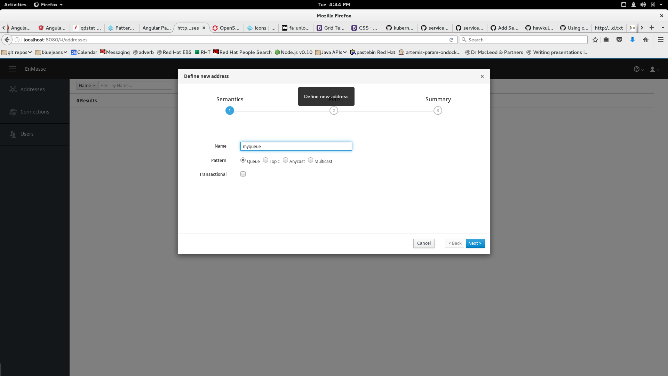
Confidential - Do not duplicate or distribute without written permission from Red Hat

Slide 43
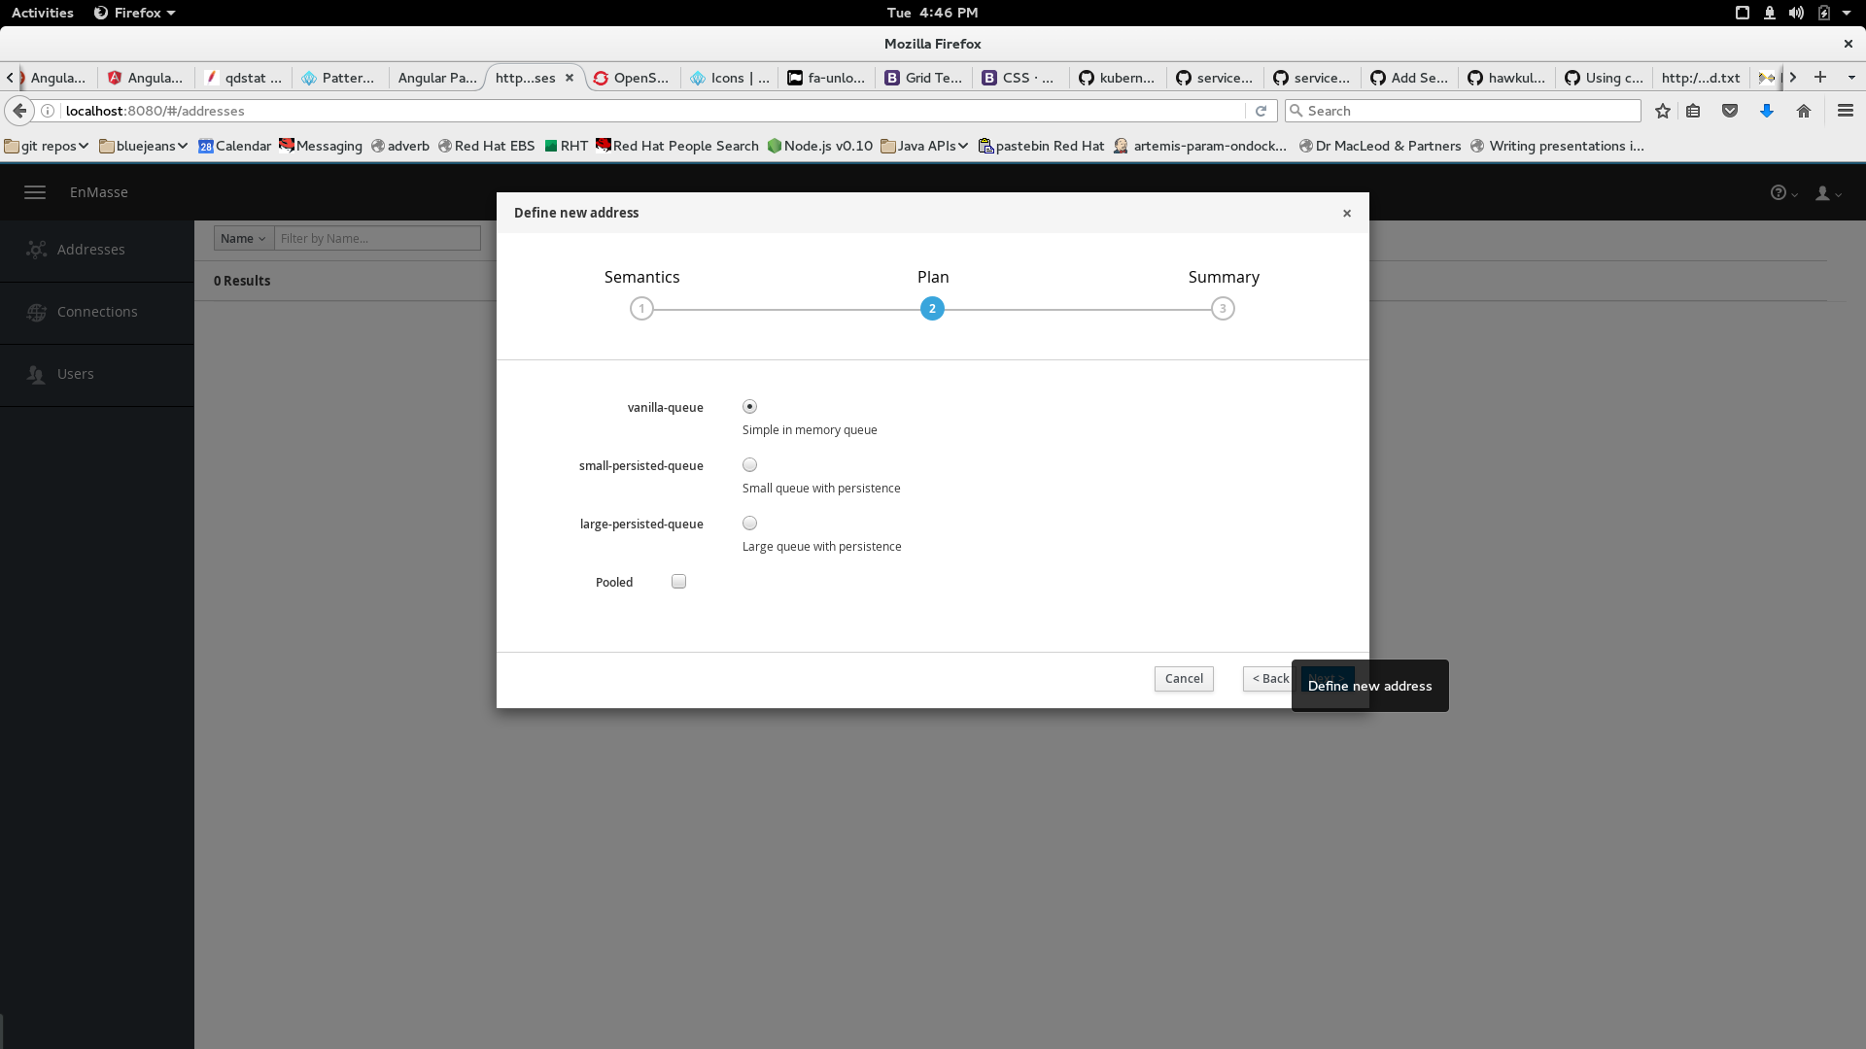
Confidential - Do not duplicate or distribute without written permission from Red Hat

Slide 44
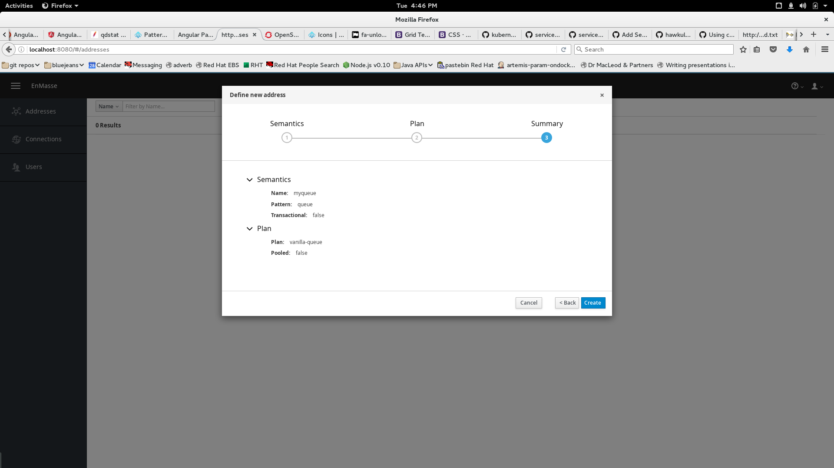
Confidential - Do not duplicate or distribute without written permission from Red Hat

Slide 45
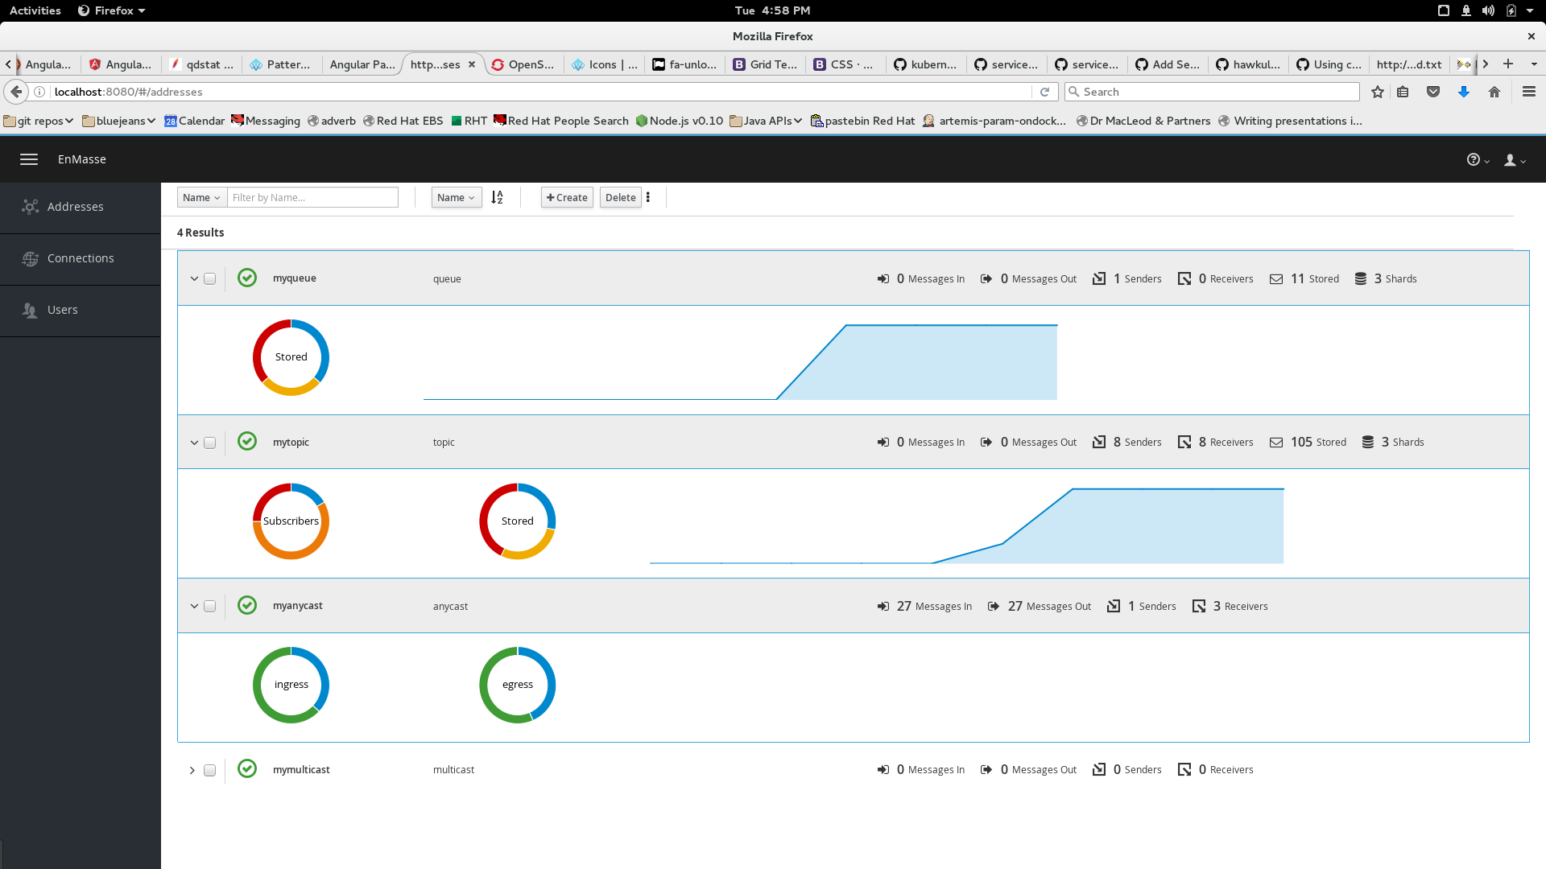
Confidential - Do not duplicate or distribute without written permission from Red Hat

Slide 46
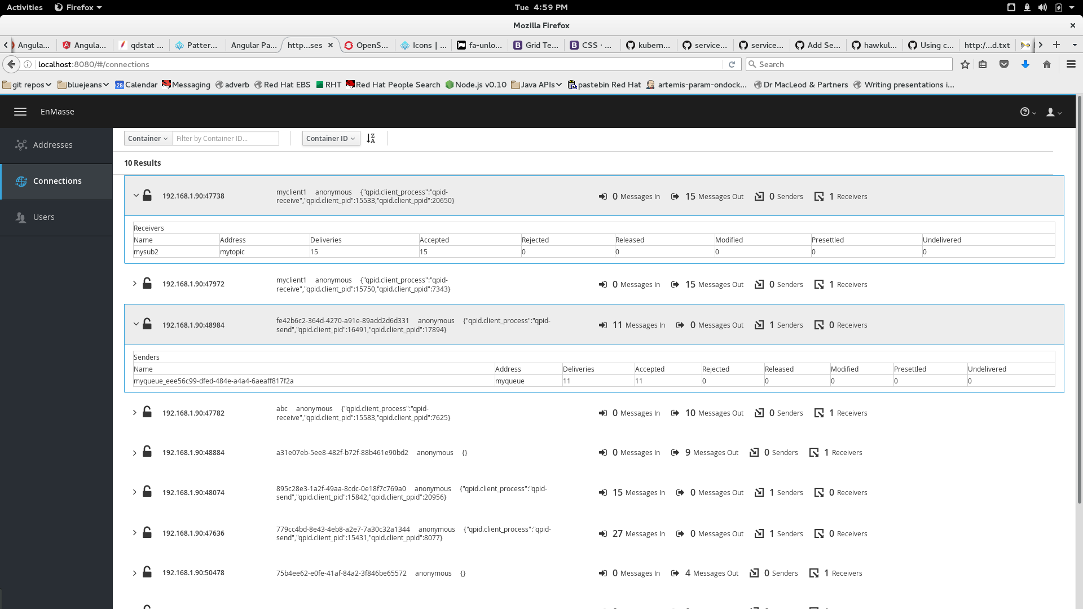
Confidential - Do not duplicate or distribute without written permission from Red Hat

Slide 47
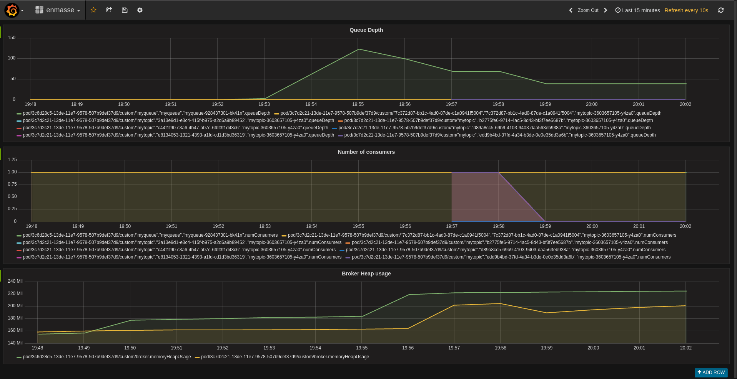
Confidential - Do not duplicate or distribute without written permission from Red Hat
Notes:
Hawkular openshift agent runs on all nodes - uses DaemonSet – 1 instance per machine
In broker pods, mount config map to special path called Hawkular OpenShift Agent volume. Specify endpoint type (Jolokia) and HTTP path to endpoint

Slide 48
summary
Confidential - Do not duplicate or distribute without written permission from Red Hat

Slide 49
Summary
Red Hat JBoss AMQ 7
AMQ 7 is the next major release of the popular messaging platform
Improved broker performance and scalability
New Interconnect router
New AMQP 1.0 clients
Standard protocols
Flexible, standards-based messaging for the enterprise, cloud and Internet of Things
Common tooling
Broker
Interconnect
Clients
AMQ 7 generally available this week
AMQ 7 on OpenShift aka Messaging-as-a-service (MaaS) coming soon
Confidential - Do not duplicate or distribute without written permission from Red Hat

Slide 50
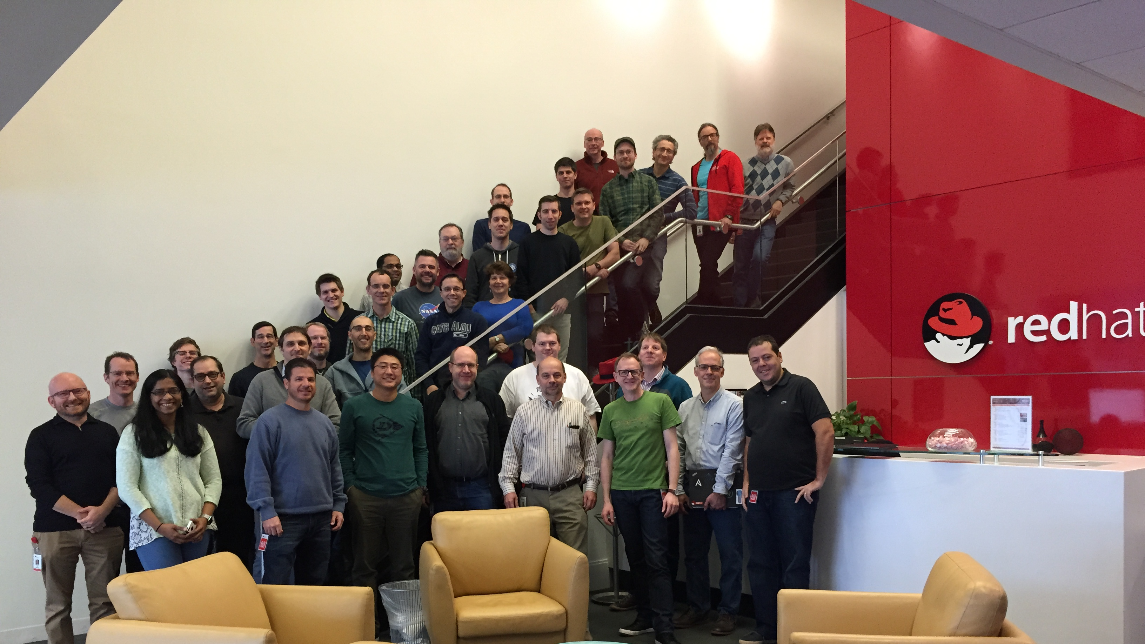
Thank You! Any Questions?

Slide 51
Messaging at Red Hat Summit
Tue May 2, 4:30 PM - 5:15 PM – Room 153A – S104965 – David Ingham Introducing JBoss AMQ 7 - messaging for the enterprise, cloud, & IoT
Wed May 3, 12:40 PM - IoT Booth in the Partner Pavilion – David Ingham JBoss AMQ 7 and IoT
Wed May 3, 4:30 PM - 5:15 PM – Room 155 – B104701 – Mark Wagner JBoss AMQ performance and scalability
Thu May 4, 10:15 AM - 11:00 AM – Room 104C – S104971 – Ted Ross & David Ingham JBoss AMQ 7 technical deep dive
Thu May 4, 3:30 PM - 4:15 PM – Room 151B – S104305 – Christian Posta & Paolo Patierno JBoss AMQ and Apache Kafka—which to use?
Confidential - Do not duplicate or distribute without written permission from Red Hat

Slide 52

Confidential - Do not duplicate or distribute without written permission from Red Hat

Slide 53
SPARE SLIDES
Confidential - Do not duplicate or distribute without written permission from Red Hat

Slide 54


Broker use-cases temporal decoupling (1/4)
Confidential - Do not duplicate or distribute without written permission from Red Hat

Slide 55


Broker use-cases temporal decoupling (2/4)
Confidential - Do not duplicate or distribute without written permission from Red Hat

Slide 56
Broker use-cases temporal decoupling (3/4)
Confidential - Do not duplicate or distribute without written permission from Red Hat

Slide 57
Broker use-cases temporal decoupling (4/4)
Confidential - Do not duplicate or distribute without written permission from Red Hat

Slide 58

Broker use-cases load levelling
Confidential - Do not duplicate or distribute without written permission from Red Hat

Slide 59
Broker use-cases load balancing
Confidential - Do not duplicate or distribute without written permission from Red Hat

Slide 60
AMQ 7 Timeline
Alpha
Jun ‘16
Beta 1
Dec ‘16
Beta 2
Feb ‘17
GA
May ‘17
Note: MaaS is still under active development. Preview releases planned during 2017.
Confidential - Do not duplicate or distribute without written permission from Red Hat

Slide 61

Thank You! Any Questions?
@dingha
Confidential - Do not duplicate or distribute without written permission from Red Hat

